Slide 1

WAVA
Community Engagement
Opportunities:
Clubs
Competitions
Outings
K12 Zone
K12 Enrichment Programs
Career Prep
CTSO Clubs
ASB
Student Council
LC Community
Padlet
Spirit Days
Project Elevate

Slide 2
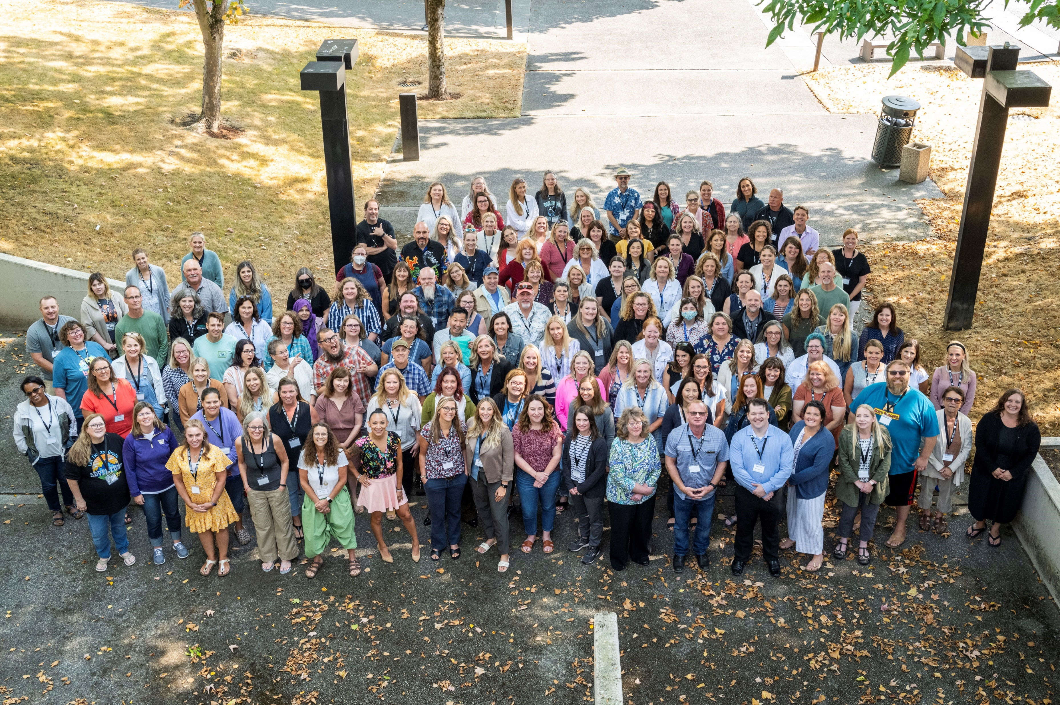
WAVA Community Engagement
Clubs:
Baking, Art, Music,
Book Club, Fitness Club,
D&D, and GLSEN
ASB HS, ASB MS
Competitive Clubs/Teams:
Esports League and Robotics
CTSO Clubs:
SkillsUSA, FBLA HS/MS, TSA
HOSA, FCCLA
National Competitions:
Innovation Challenge
Art Competition
Photography Challenge
Cooking Challenge
Senior Reel
Minecraft Challenge
Game Design

Slide 3
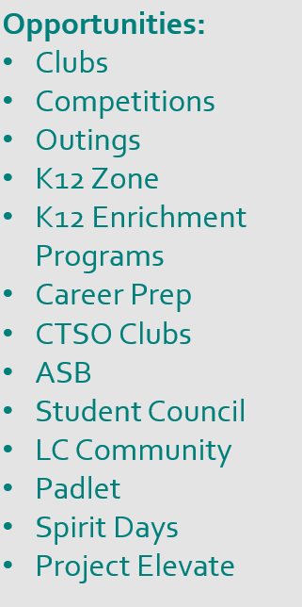
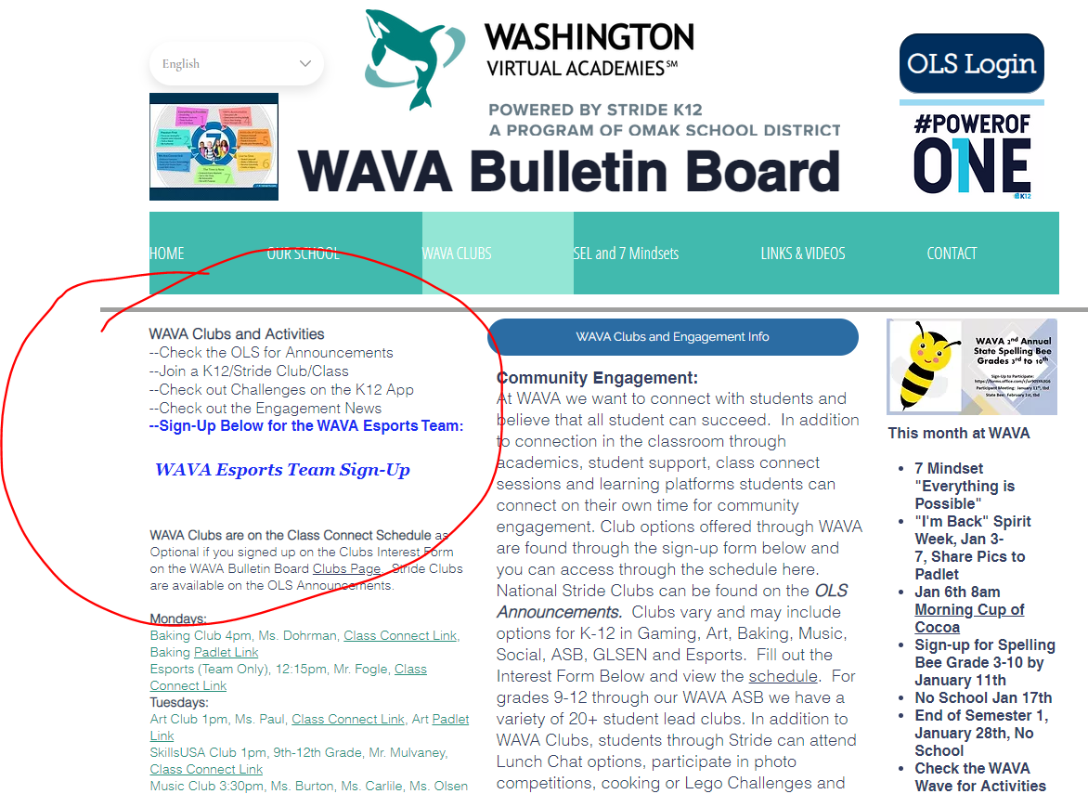
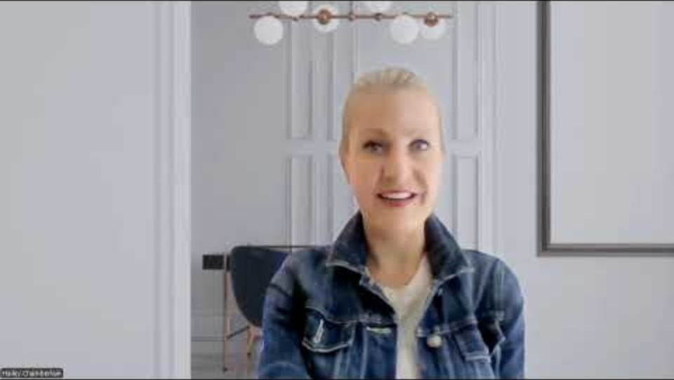
Get Involved in Clubs
Clubs start in October. Anyone can attend!
https://www.wavabulletinboard.com/esports-and-clubs
Join a Club either through your OLS or links on the on the Bulletin Board website and email!
Club info is updated regularly on the WAVA Bulletin Board Clubs Page
Check your monthly WAVA Newsletter and National Newsletters
Check your OLS Announcements for National K12 Clubs and Challenges regularly https://www.k12.com/parent-student-resources/extracurriculars-events/
Email: clubs@k12.com for National Club Support and hchamberlain@wava.org for WAVA Support

Slide 4

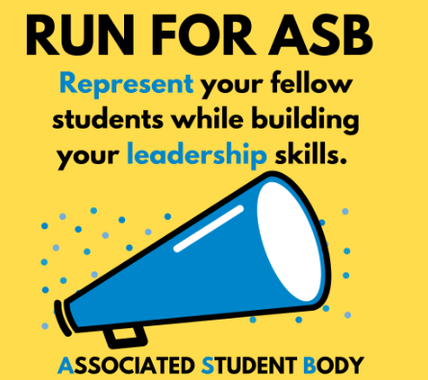
ASB at WAVA for MS and HS
ASB is our WAVA Associated Student Body. Our ASB meets for Middle School and High School throughout the year. WAVA ASB promotes student leadership and student-led activities. Some activities that Students participate in can include monthly focus events, Chill N' Chat, socializing opportunities, assemblies, Senior Days and Graduation. ASB includes our ASB Advisor and leadership roles that students can apply or express interest in. ASB meetings will show on your Class Connect Schedule. Advisors will reach out after school begins for interest.

Slide 5

Get Involved in Competitions
How can I participate in a K12 Competition throughout the year? Visit the K12 Enrichment Page to view current competitions happening:
Home - K12 Enrichment
What type of Competitions are offered throughout the year:
Photography
Art
Game Design
Innovation
Cooking Challenge
National Robotics
My Senior Reel
Minecraft

Slide 6
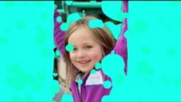
WAVA Outings
WAVA hosts outings are offered throughout the year! Check the Outings Link on the WAVA Bulleting Board!
Every Friday 12-2pm Meet for Park Days throughout WA!
Back to School Picnic Date: 09/20
Outings vary by grade and can include activities like museum tours, hikes, picnics, nature explorations, science fairs and more.
Don’t see an outing near you, suggest to your teacher!
Find the outings link on the WAVA Bulletin Board.
WAVA Outings List.xlsx
If you don’t see an outing in your area, you can post your own outing on the WAVA LC Community! Outings are optional and not required.
Let’s get connected!
https://www.wavabulletinboard.com

Slide 7
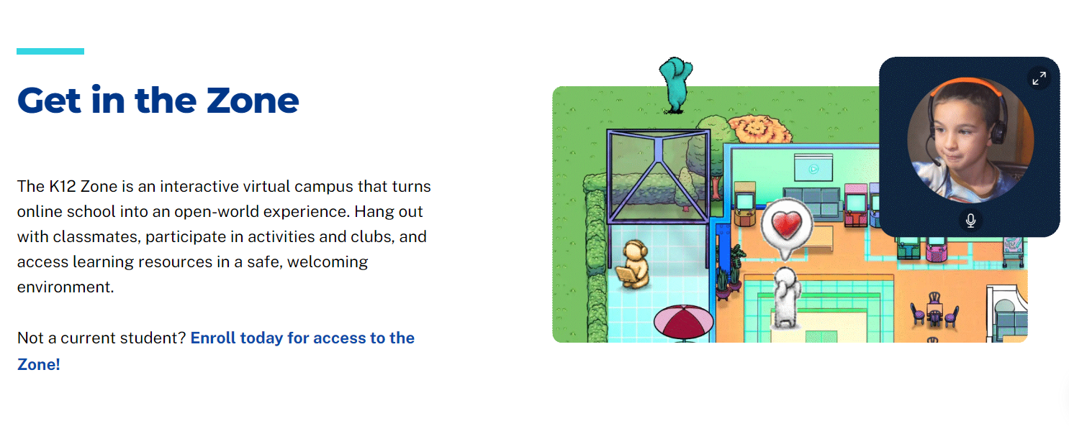
Visit the WAVA K12 Zone
K12 Zone - K12
Meet students in the Zone for socialization, chat, activities, games and challenges. WAVA Zone is open Monday to Friday 12-4pm. WAVA Zone is open for K-2, 3-5, 6-8 and the National K12 Zone for 9-12. Students can access the Zone through the OLS. Questions, hchamberlain@wava.org

Slide 8
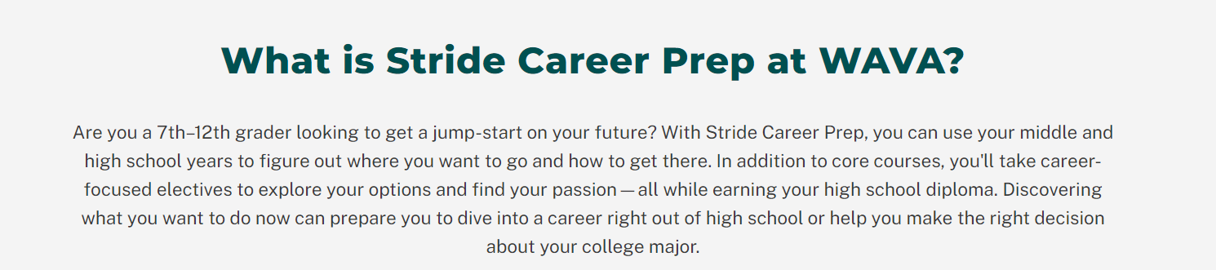
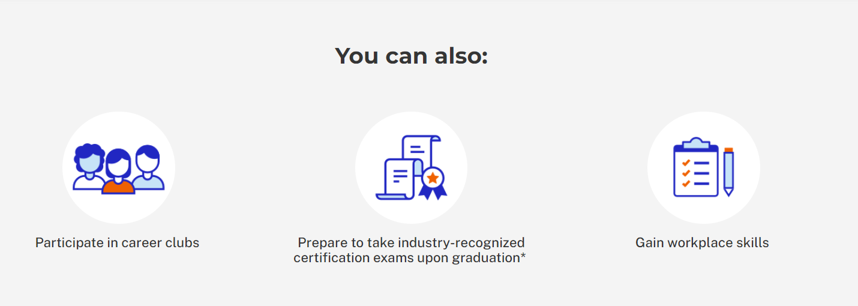
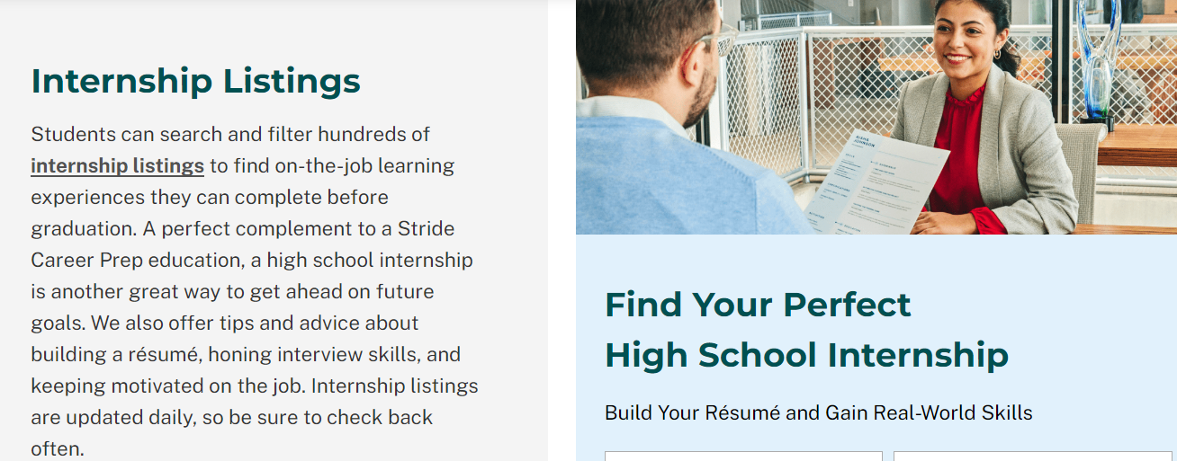
Career Prep at WAVA for Grades 7-12
Questions on Career Prep: tkreilmann@wava.org

Slide 9
WAVA CTSO Clubs:
SkillsUSA
FBLA
FCCLA
HOSA
TSA
Contact: CTE Admin
Taylor Kreilmann, tkreilmann@K12.com
Career and Technical Student Organizations (CTSOs) extend teaching and learning through innovative programs, business and community partnerships and leaderships experiences. CTSOs are a powerful avenue for helping our nation address key challenges such as workforce development, student achievement, economic vitality and global competitiveness. By joining, students learn more about careers, post-high school education, and training opportunities. They develop leadership skills that will prepare them for work and can test their skills in local, state, and national competitions.
FCCLA Family and Consumer Sciences Education
HOSA Health Professions
SkillsUSA Career and Technical Education
FBLA Future Business Leaders of America
TSA Technology Students of America

Slide 10
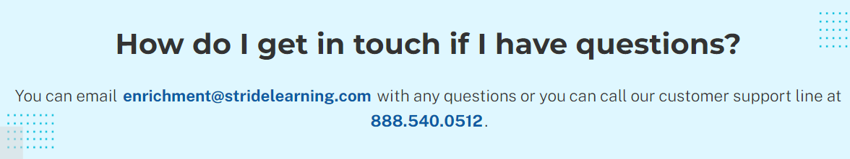
K12 Enrichment Programs Available to MS/HS:
Learn new skills a professional development opportunities
Drone Flight Certification
Entrepreneur Skills
Creative Storytelling with Photography
Video Game Design
Virtual Reality Development
Mobile App Development
Interior and Environmental Design
Comic Illustration
Fashion Design
Robotics
Screen Writing
Business for Musicians

Slide 11






Stay Connected
Connect and follow online for daily and weekly updates on school activities and events. Follow on FB, Instagram, Padlet, YouTube, WAVA Bulletin and K12, Monthly Newsletters, LC Community.
https://www.wavabulletinboard.com

Slide 12
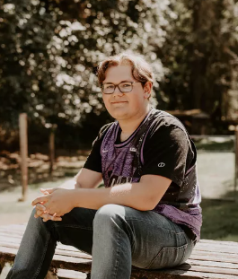
Helpful Links to Bookmark
WAVA Bulletin Board, https://www.wavabulletinboard.com
WAVA K12 Site, https://wava.k12.com
K12 Zone, K12 Zone - K12
LC Community available through the OLS (re-launching soon)
WAVA Instagram, https://www.instagram.com/washington_virtual_academies/
WAVA FB, https://www.facebook.com/WashingtonVirtualAcademies
WAVA YouTube, https://www.youtube.com/channel/UCxfglETY4qToYKr96ZeHDNg/videos
WAVA Padlet, https://www.tinyurl.com/wavapadlet (post and share)
National Career Prep Clubs, https://www.k12.com/stride-career-prep/about/student-advisory-council.html
National Stride Engagement, https://www.k12.com/parent-student-resources/extracurriculars-events.html
National Stride Social Events and Activities, https://www.k12.com/parent-student-resources/extracurriculars-events/events-calendar.html

Slide 13
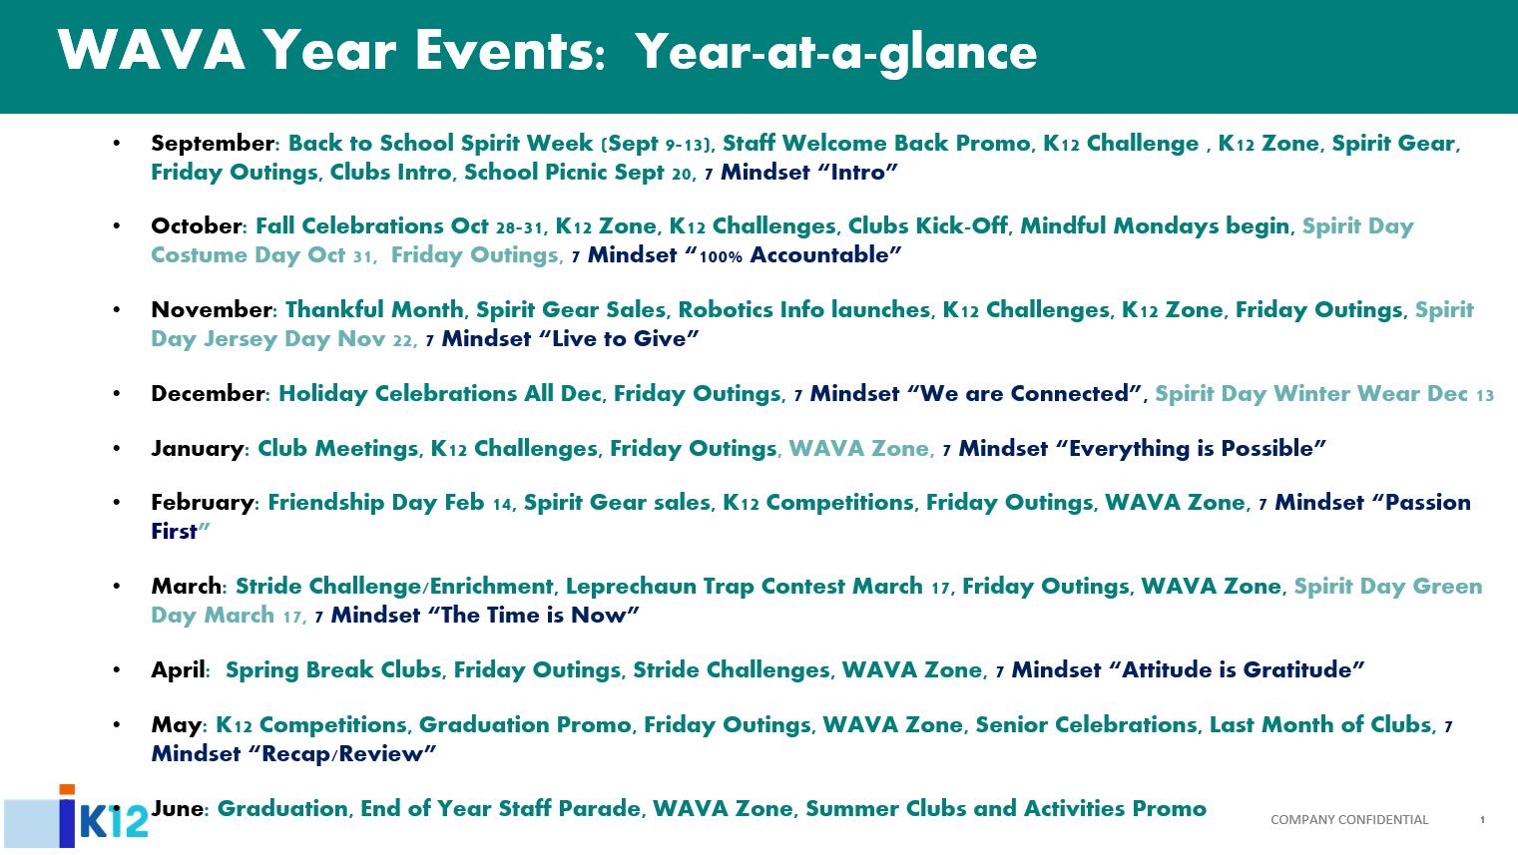

Slide 14
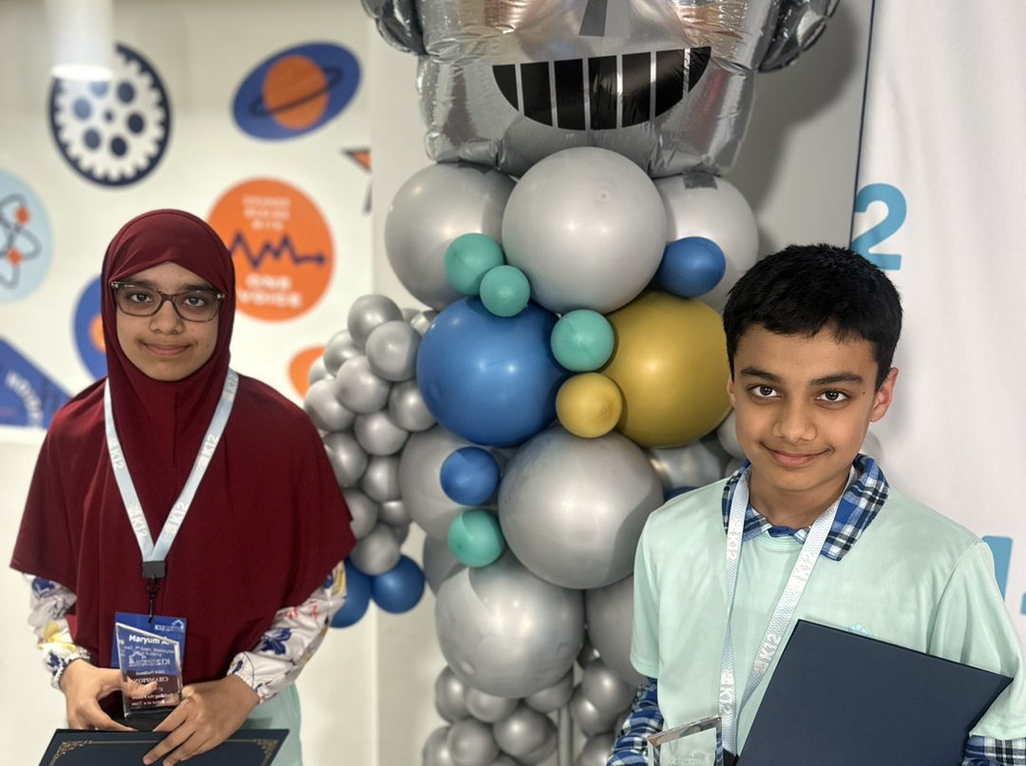
Share Your Story with WAVA
What talents or stories do you have to share?
Did you know? What do you know about your teacher or your fellow students? Do you have a fun story to share about yourself or a unique talent? Are you a select athlete, in a traveling band, competing in equestrian or other talents? WAVA wants to know!
Share to Project Elevate https://elevate.press/link for a chance to be featured in your local news and press.
Did you know the WAVA Student Ilyannie Gonzalez has won the National K12 Spelling Bee 3 years in a row, won the National Innovation Challenge, won her local Spelling Bee and is a published author!
Did you know the Ayaz siblings have won the National Robotics Competition 2 years in a row! Share your story and be featured in our news!

Slide 15

Welcome Back WAVA-Student Videos/Pics
Videos of Alumni Students:
Alumni Student Pics 2024: https://youtu.be/NiVCJwgwgik
Alumni Student Pics from 2023: https://youtu.be/OkmQUR7u9W0
Alumni 2024 Student Aristotle R: https://youtu.be/LX4axJbi4Ic
Alumni 2024 Student M Martinez: https://youtu.be/aHROXku2x84
Alumni 2024 Student Matthew G: https://youtu.be/ixznAtBpPwc
Student Fun Pics/Videos:
Previous Year Back to School Picnic Video: https://youtu.be/_eOE8qk77jQ
Student/Pet Greeting: https://youtu.be/xm1AOg7nENs
Previous Years "Why We WAVA" Video: https://youtu.be/EwglQ4_sMhI
K-5 Student Message- Kaleb: https://youtu.be/eOclSgpLcX4
Previous Clubs Video: https://youtu.be/xevHueRqyF8
WAVA Baking Padlet Recipes with Mrs. Wilson to view: https://padlet.com/haileycpak/baking-club-pics-2aechs1d2nripy2x
Visit WAVA YouTube

