Slide 1




WASHINGTON VIRTUAL ACADEMIES
A Program of the Omak School District
Welcome!
WAVA 2022-23 Information Night
Spring 2022
All students are capable of success. No exceptions.
Powered by

Slide 2
Agenda
1
Welcome & Introductions
6
WAVA High School
2
Padlet? What’s a Padlet?
7
Counseling at WAVA
3
WAVA Elementary School
8
Flex Option
4
WAVA Middle & High Schools
9
WAVA Clubs & Social Opportunities
5
WAVA Middle School
10
Questions & Answers

Slide 3
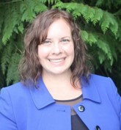
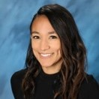

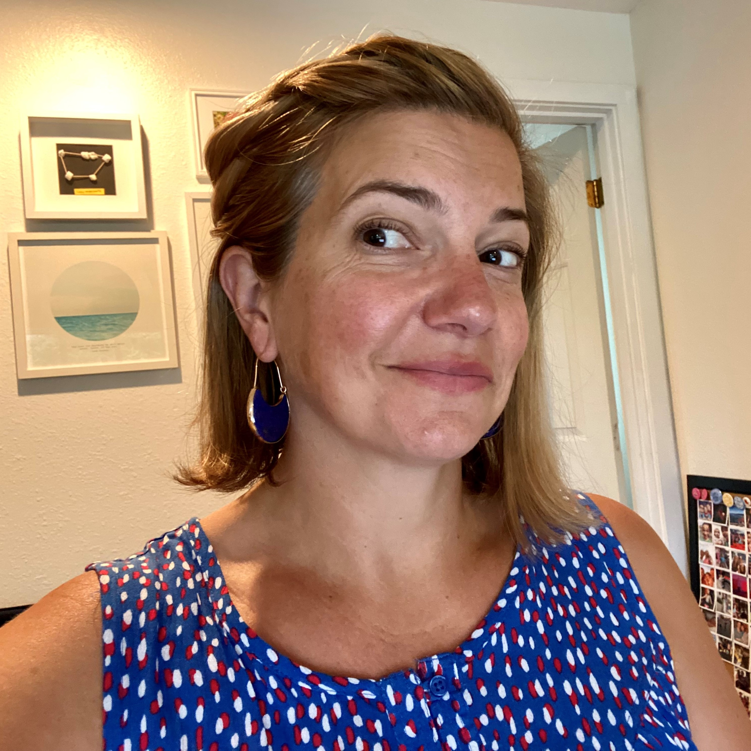
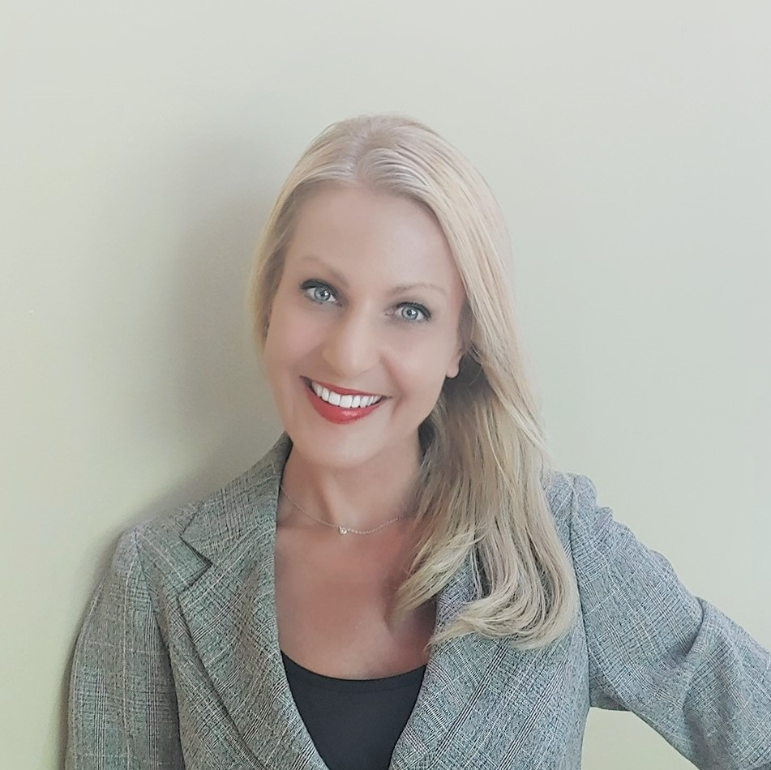
Welcome & Introductions
Ms. Susan Boyer Executive Director
Ms. Amalia Walle
K-5 Principal
Mr. Terry Ackerman
6-12 Principal
Ms. Rosie Bailer
Flex Coordinator
Ms. Hailey Chamberlain
Community Engagement
Notes:
Ms. Susan Boyer
WAVA Executive Director

Slide 4
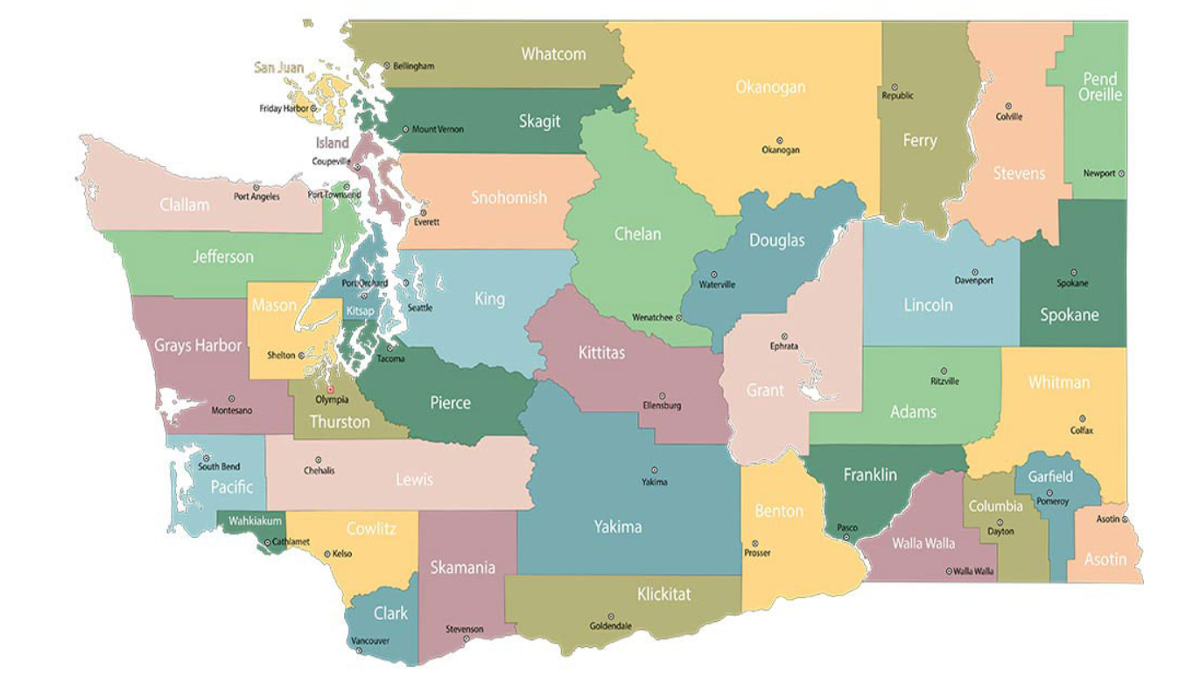


Washington Virtual Academies & Omak School District
Omak School District
Omak, WA
WAVA Admin Office
Tacoma, WA
Map source: WA State Dept of Commerce

Slide 5
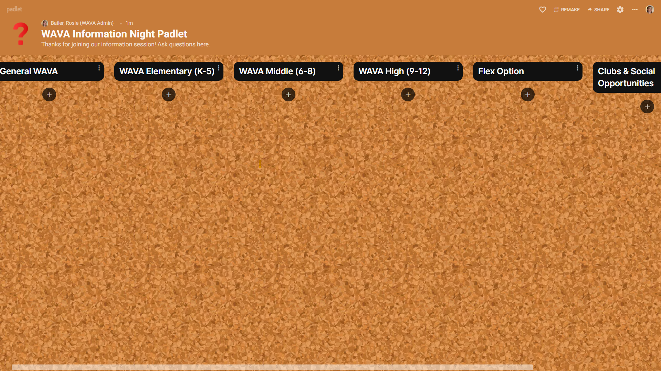
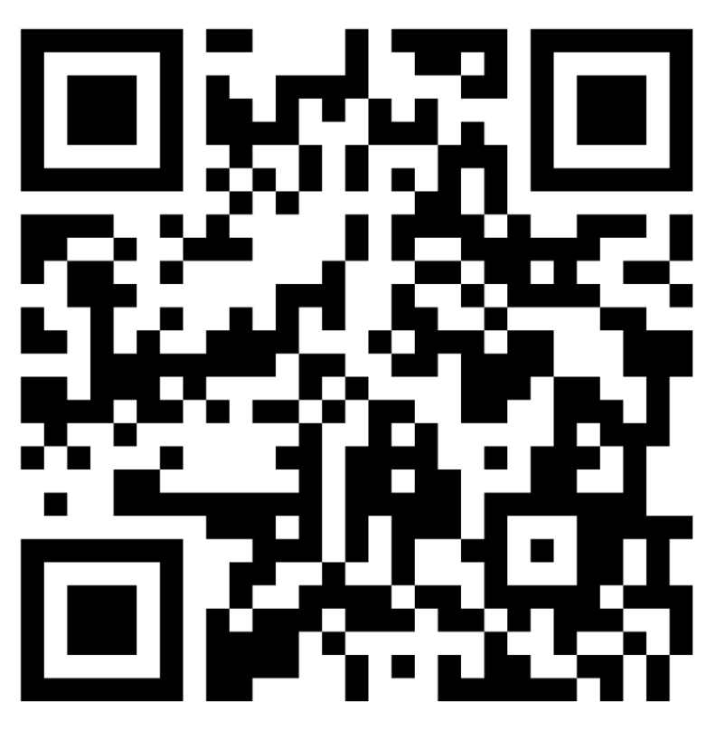
Padlet?
What’s a Padlet?
Padlet (noun): a virtual space for collecting ideas
https://padlet.com/ rbailer_wava/ j8gakz8adq7v1lpa

Slide 6
WAVA
Elementary School
Ms. Amalia Walle
K-5 Principal
awalle@k12.com

Slide 7

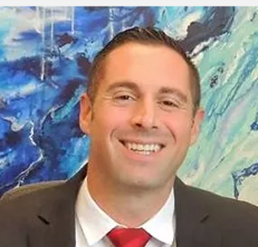
K-5 Team Principal Amalia Walle
K-5 Team Assistant Principal Taylor Kreilmann
K-5 Team Assistant Principal
Russell Kovalenko

Slide 8
This Year at WAVA Elementary
2021-22 Enrollment (3/7/21)
Grade | Students
K | 284
1 | 277
2 | 344
3 | 387
4 | 406
5 | 431
Elementary Total | 2,129
Kinder classes were maxed at 25 students
We taught 10 full classes of Kinder!
We accommodate 14% of our student population with Specially Designed Instruction
We are providing FREE Summer School for our 2-5th grade students
We offer an array of social clubs during the school day

Slide 9
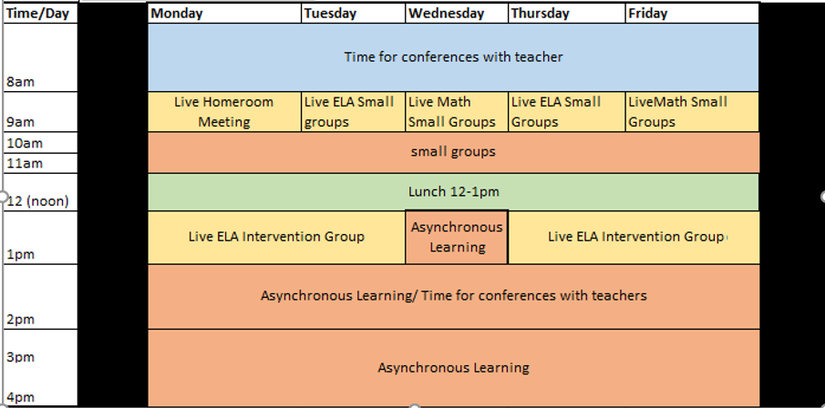
A day in the life…
K-5 Example Schedule
Adjustments made for:
Students in Special Programs (Special Education, ELL, Highly Capable, etc.)
Mandatory state & local testing days
Whole school assemblies, events, etc.
School counselor-led social & emotional learning sessions held daily for ALL K-5 students

Slide 10
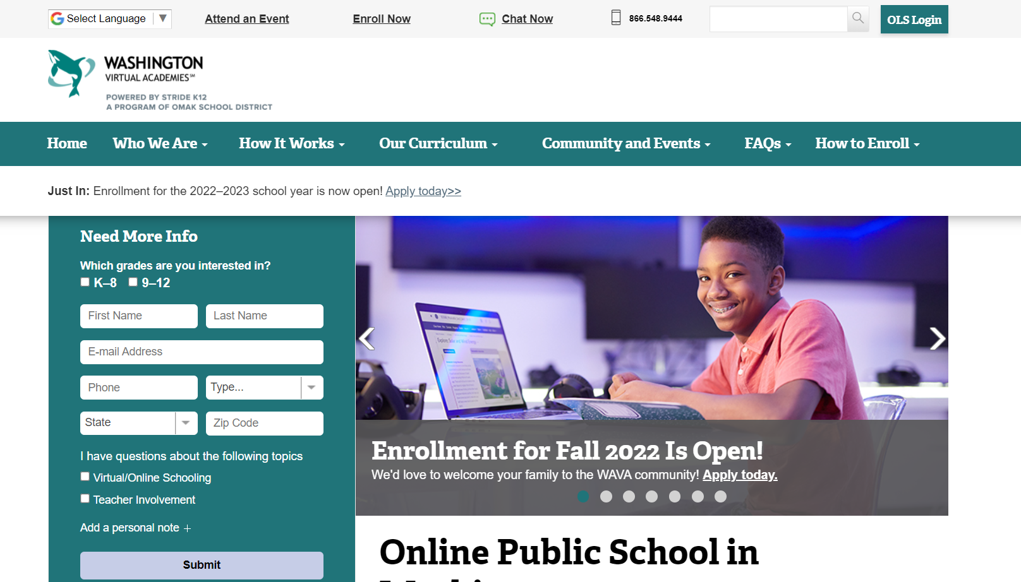
Yes!
You still have time to register for WAVA 22-23!
https://wava.k12.com/

Slide 11

WAVA
Middle & High School
Mr. Terry Ackerman
6-12 Principal
tackerman@k12.com

Slide 12

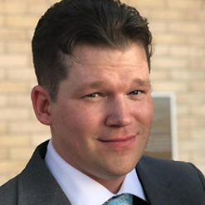
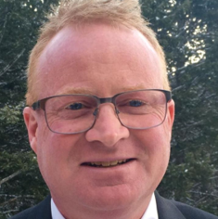
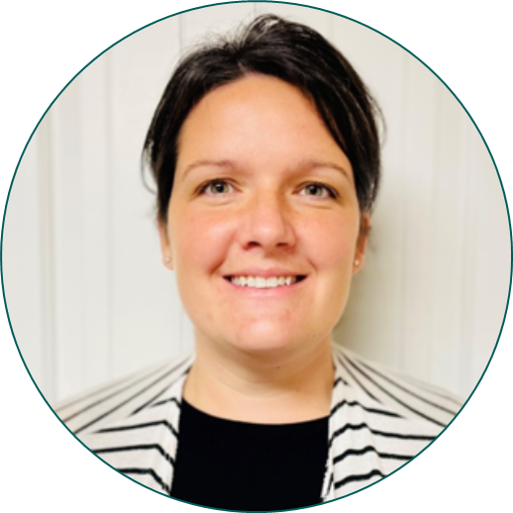
6-12 Principal Terry Ackerman
6-12 Assistant Principal
Mark Lagerquist
6-12 Assistant Principal Tom Yahraes
Administrative Intern
Lia Carlile

Slide 13
We are WAVA! North of 3,000 6-12 students… and growing!
2021-22 Enrollment (3/7/21)
Grade | Students
6 | 499
7 | 573
8 | 524
Middle School Total | 1,596
9 | 423
10 | 439
11 | 331
12 | 294
High School Total | 1,487

Slide 14
The Priorities for WAVA High and Middle School
​
Priority Area I: Students First​
Priority Area II: Academic Achievement​
​
Priority Area III: Community Partnerships​
​
Priority Area IV: Positive Staff and Student Culture

Slide 15
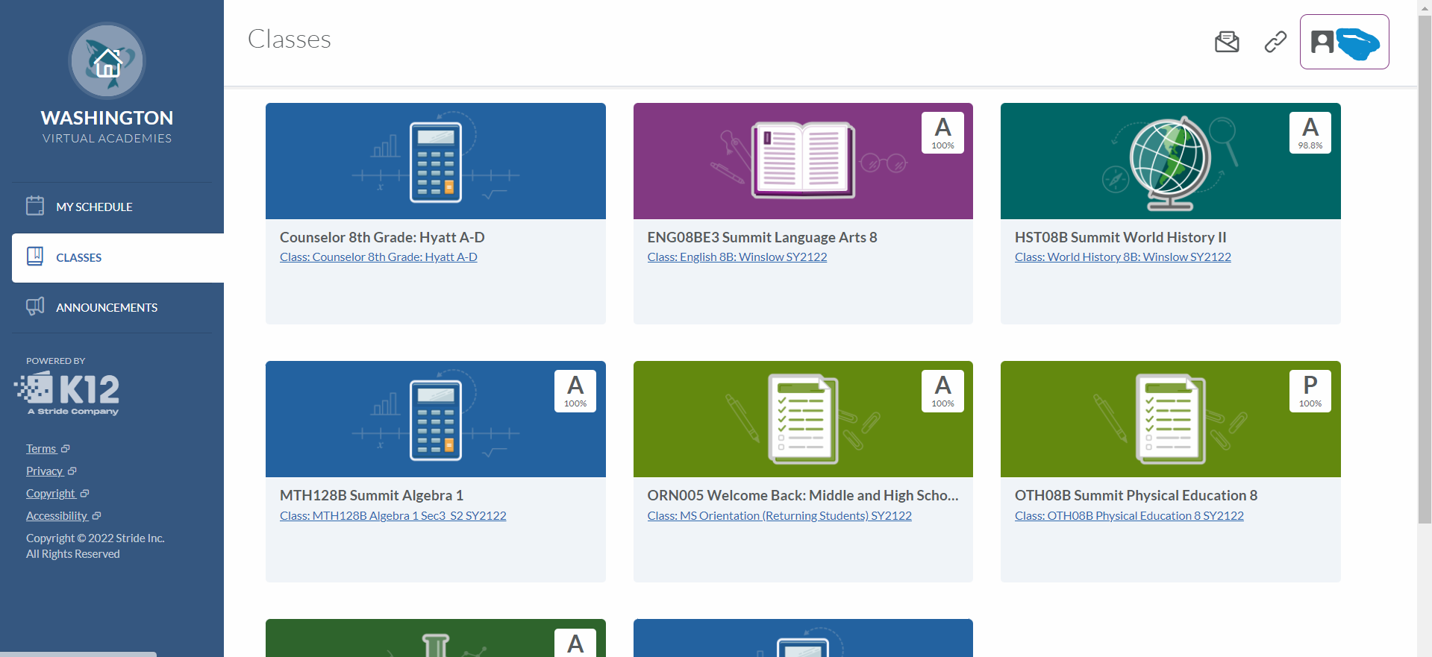
What does online school look like?

Slide 16
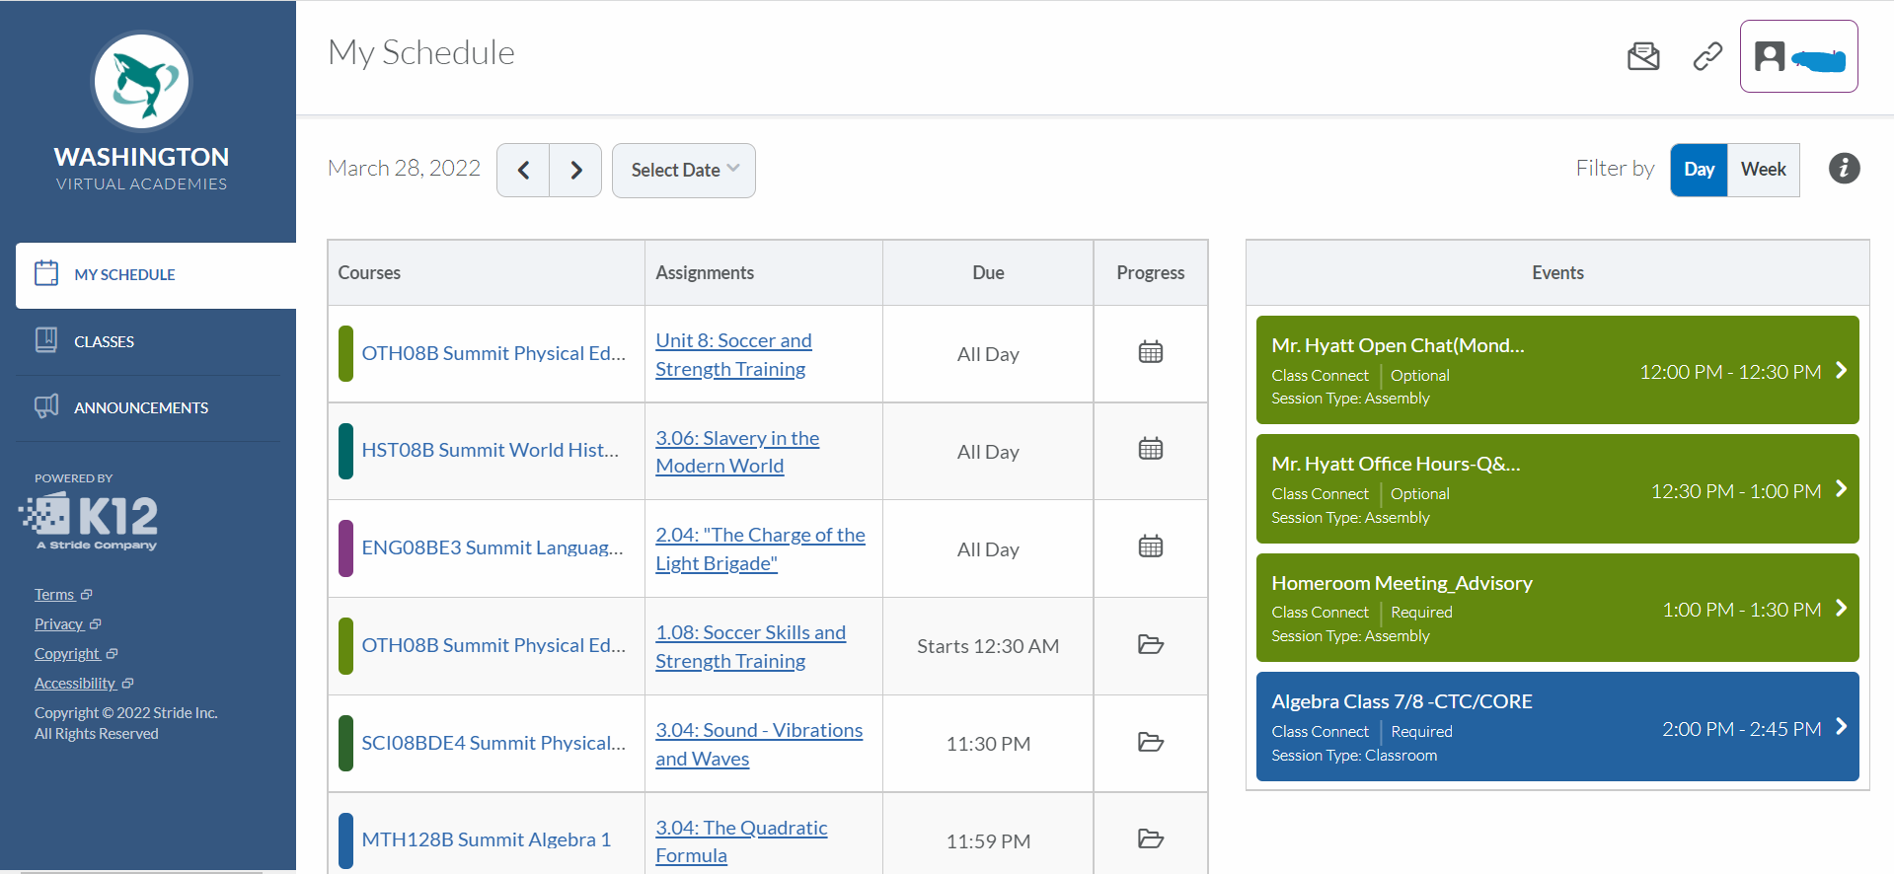
What does online school look like?

Slide 17
WAVA
Middle School
Mr. Terry Ackerman
6-12 Principal
tackerman@k12.com

Slide 18
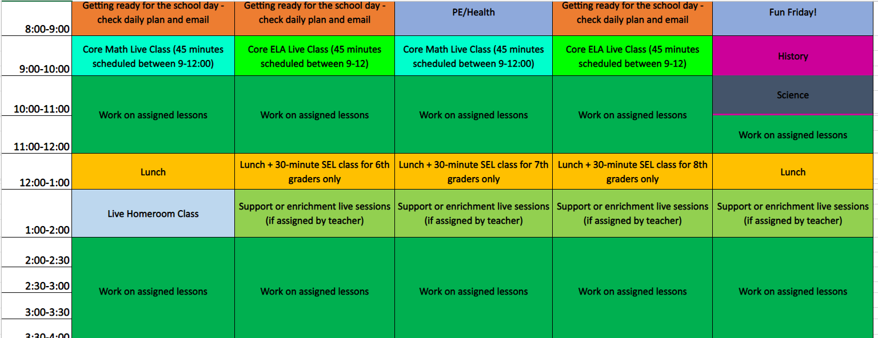
What does a MS schedule look like?

Slide 19
What's new at WAVA MS for 2022-23?
Expanded Course Offerings
Career & Technical Education (CTE):
Exploratory CTE Course
CTE Computer Literacy Course
CTE Achieving your Career and College Goals Course
Advancement Opportunities
Earn HS credit while at MS: Algebra 1, English 9
Get ready for Career Prep at WAVA Program

Slide 20
WAVA
High School
Mr. Terry Ackerman
6-12 Principal
tackerman@k12.com

Slide 21
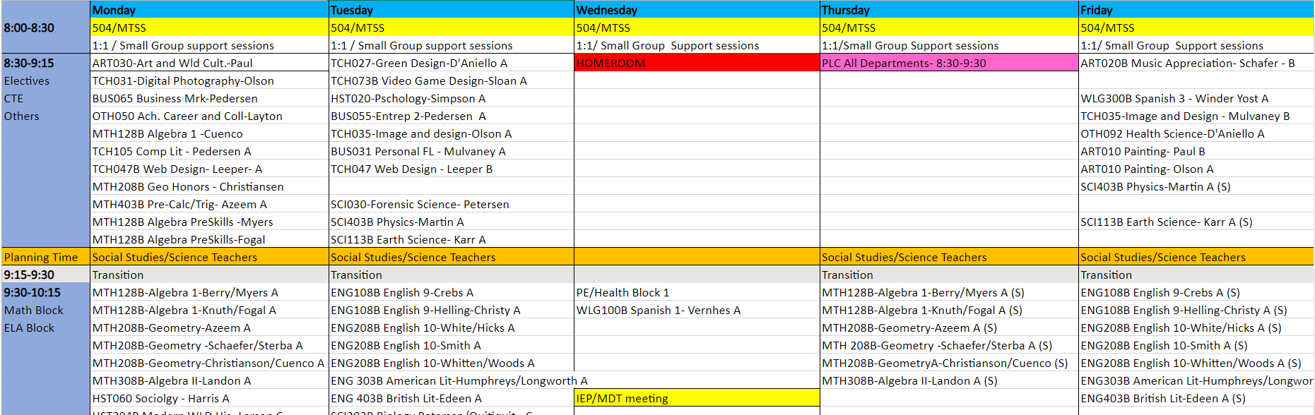
What does a HS schedule look like?

Slide 22
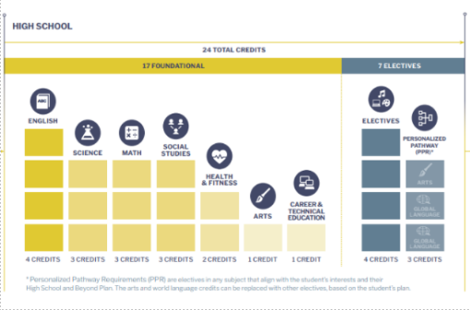
WAVA HS Course Catalog
WAVA Course Catalog 2021-2022 v6-9-21.docx

Slide 23
What's new at WAVA HS for 2022-23?
Expanded Course Offerings
Leadership Opportunities
College Credit Opportunities
Career Prep at WAVA
  career-focused experience
  classes, coursework, internships, clubs and enrichment programs
  partnerships with local businesses and organizations
  job shadow opportunities, internships, job placement and mentorship
ASB Leadership
Elected Officers
Homeroom Participation
Chill ‘n’ Chat
In-Person Events!
2022-2023 Career Prep at WAVA Areas
Business and Finance
Manufacturing and Trades
Health Science and Medical Technology
Marketing, Sales and Services
Information Technologies (Programming and Security)
State Fair
Local & Regional Gatherings
Prom
Graduation/Receptions

Slide 24
Commonly Asked Questions
Can I attend WAVA part-time?
Can I play sports at my local high and still attend WAVA?
Can I graduate with a Washington State high school diploma through WAVA?
Are there social opportunities at WAVA?
Am I going to be attending classes all day at WAVA?
Does WAVA participate in Running Start?

Slide 25
School Counseling at WAVA

Slide 26
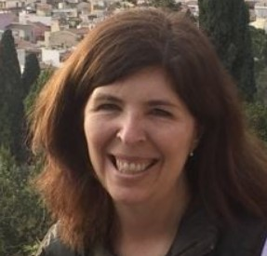
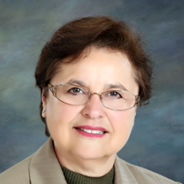

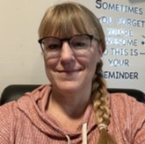
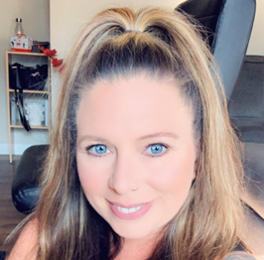
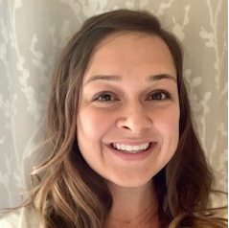

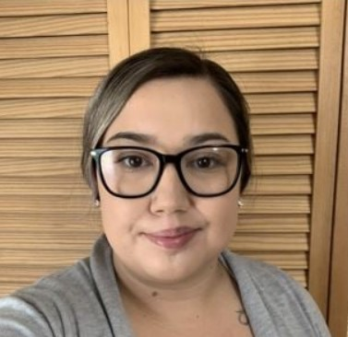

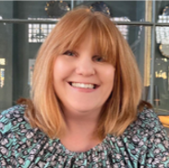
Comprehensive School Counseling Program K-12

Slide 27
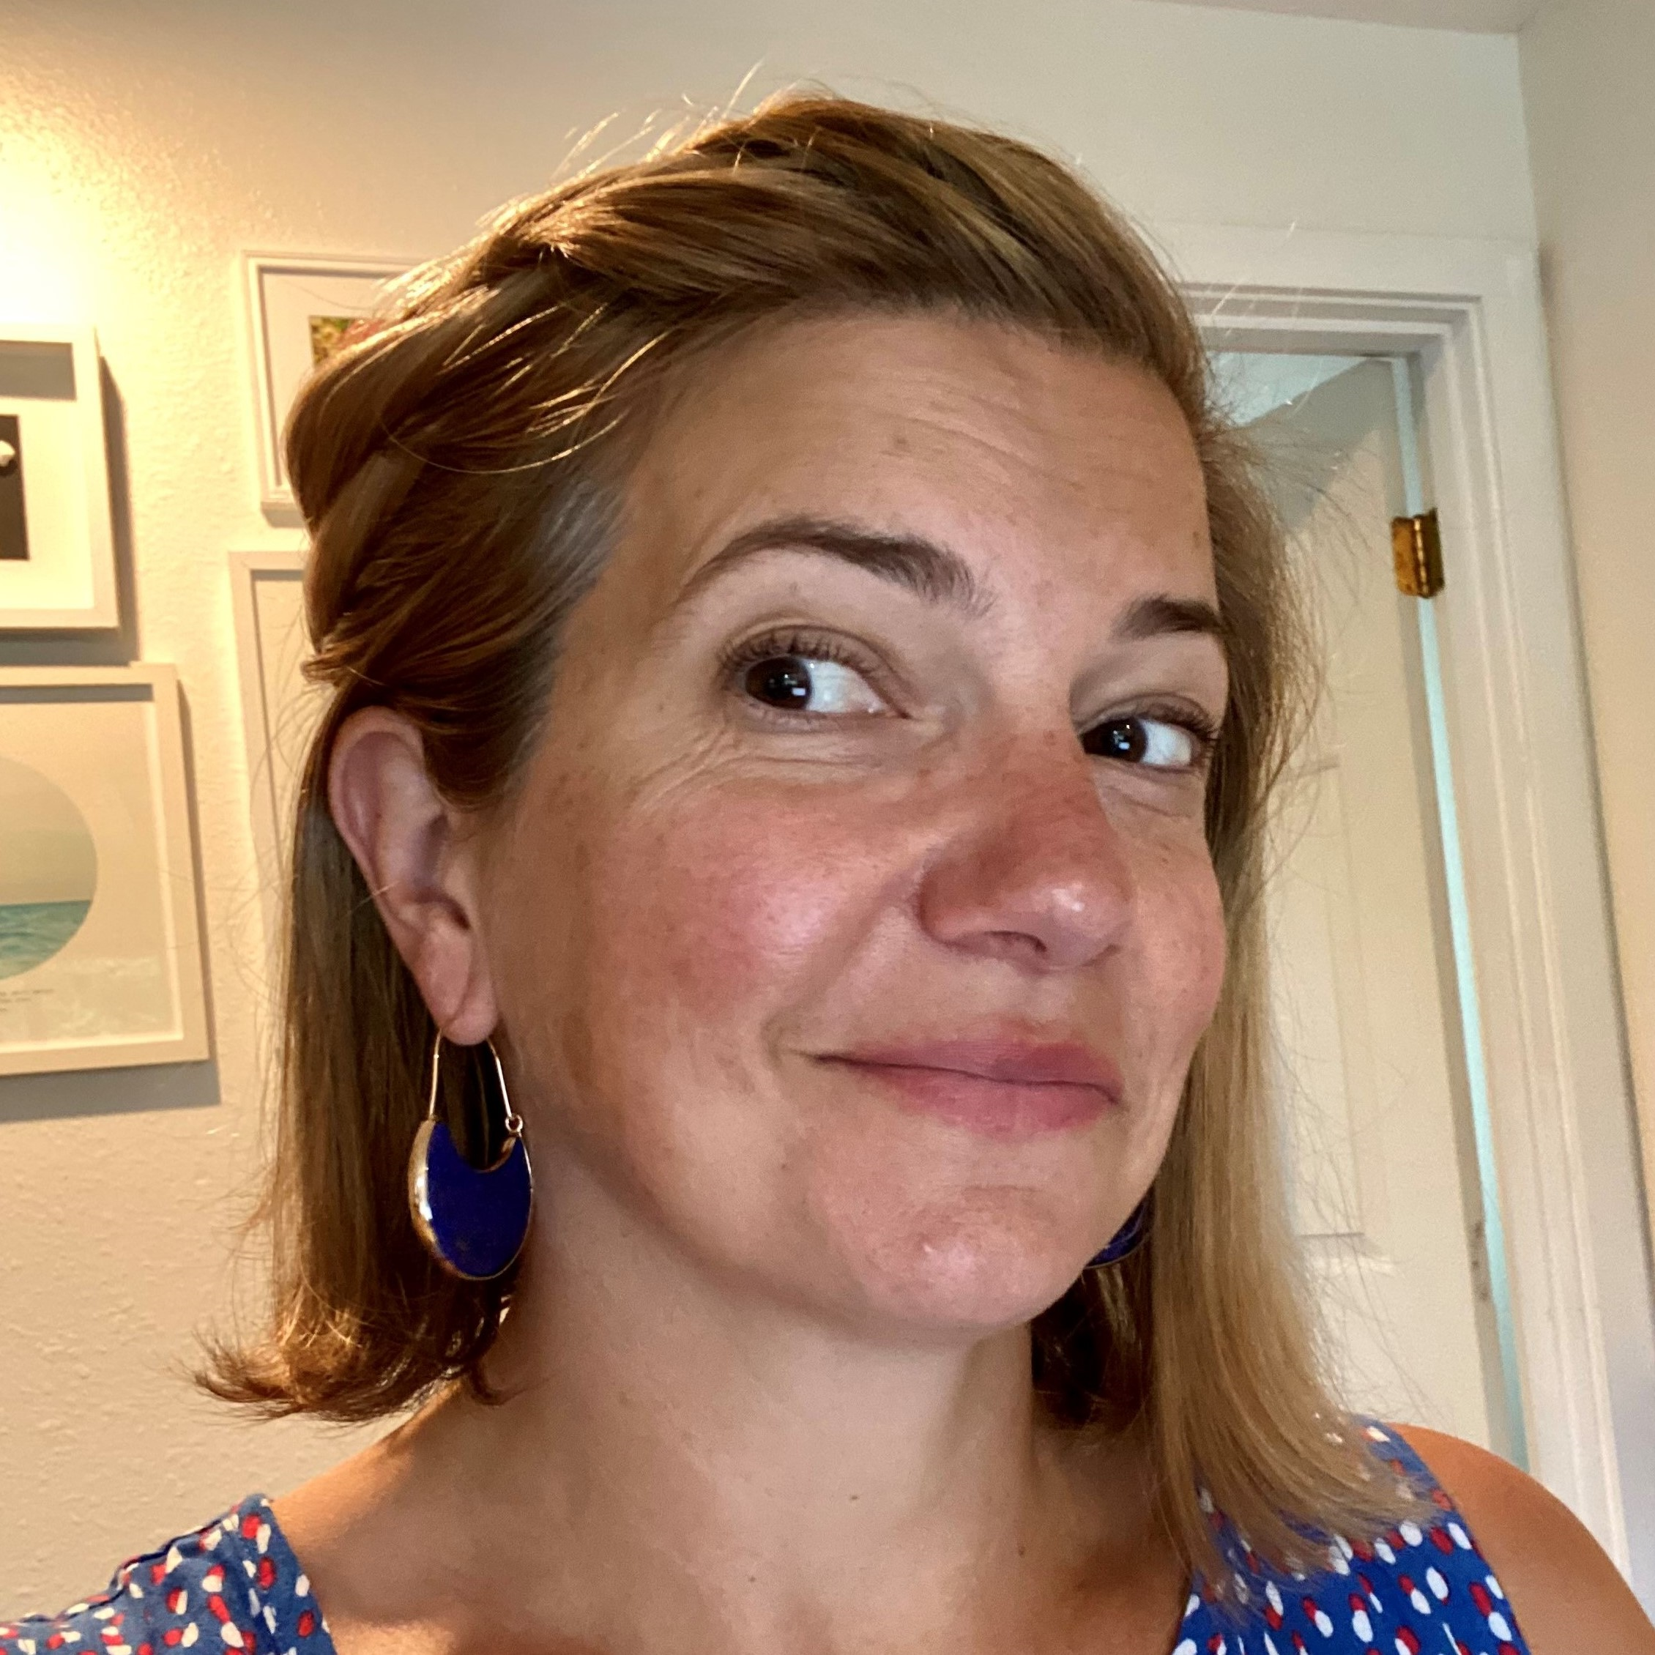
WAVA’s
Flex Option
Ms. Rosie Bailer
Flex Coordinator
rbailer@k12.com

Slide 28

What is WAVA Flex?
Alternative Learning Option at Washington Virtual Academies
WAVA Students in Grades K-12
Ideal for:
    Motivated Learners
    Independent Learners
    Learners that Engage with Online Curriculum
    Supportive & Engaged Learning Coaches
Helpful for those who require or thrive with flexible schedules due to:
    Learning Needs
    Medical Needs
    Work Responsibilities
    Caregiving Responsibilities

Slide 29
Flex Student Requirements
Routine OLS participation
    adequate time in online courses
    complete all aspects of coursework, including practice & workbook tasks
    scheduled learning time & daily practice
    academic honesty
Attending 1 weekly homeroom session live
Attending all specially designed instruction (SDI) sessions, per IEP
Scheduling & participating in student-led conferences every 4-5 weeks of school
Demonstrating learning growth via assessments, grades, progress monitoring
Participating in WAVA & state assessments (MAP, SBA, RAN/RAS, DIBELs etc.)
Notes:
ROUTINE OLS:
6-hour school day
Complete all parts of lessons – ES: get readies, learns & try its, MS/HS: practice assignments before assessments
Conferences: every 4-5 weeks of school

Slide 30
Opting into Flex 2022-23
Step 1: WAVA (Re-)Registration & Enrollment Approval
Step 2: Opt into Flex
        Flex Info Session
        Flex Conversation Phone Call
        Data Review & Follow-Up
        Notification
        Submit Flex Agreement for 2022-23

Slide 31
WAVA Flex Information Sessions
Before Spring Break
Wednesday, March 30 6:30pm Zoom Link |  | Thursday, March 31 12:00pm See LC Class Connect Schedule or Use Newrow Guest Link
After Spring Break
Tuesday, April 12 9:00am See LC Class Connect Schedule or Use Newrow Guest Link |  | Friday, April 22 9:00am Zoom Link
Would you like to be on our Flex contact list?
Flex Inquiry Form: https://forms.office.com/r/8WshKCTtW2

Slide 32
WAVA
Community
Ms. Hailey Chamberlain
Community Engagement
hchamberlain @k12.com

Slide 33
Community Opportunities at WAVA
Community Engagement
at WAVA
WAVA Clubs
2021-22
New Club Additions
2022-23
Weekly Club Meetings for Grades K – 12
Weekly Video Chat Sessions & Lunch Groups
Monthly All-School Spirit Days
WAVA Gear
Annual Spelling Bee, Science Fair, Cultural Fair
WAVA Bulletin Board
WAVA Wave Monthly Newsletters
WAVA Padlet
Project Elevate: Share Your Stories
Social Media: Facebook, YouTube, Instagram
Art
Baking
Music
Gaming
GLSEN
Social Club
Esports
ASB
SkillsUSA
Future Business Leaders of America (FBLA)
Family, Career and Community Leaders of America (FCCLA)
National Honor Society

Slide 34

National Offerings from Stride
Clubs, Challenges & Competitions
Enrichment Programs for
Middle & High School
Lego Club
Jam Club
Theater Club
Art Club
Monthly Photo Challenges
Cookoff Competitions
Drone Flight Certification
Entrepreneur Skills
Creative Storytelling with Photography
Video Game Design
Fashion Design
Mobile App Development
Interior and Environmental Design
Comic Illustration
Virtual Reality Development
Robotics
Screen Writing
Business for
Musicians

Slide 35
Questions & Answers
Ms. Amalia Walle
K-5 Principal
Mr. Terry Ackerman
6-12 Principal
Ms. Rosie Bailer
Flex Coordinator
Ms. Hailey Chamberlain
Community Engagement
Powered by

Slide 36
Yes!
You still have time to register for WAVA 22-23!
https://wava.k12.com/

